Slide 1

QUICK NOTES
From Purchasing
By Sandy Barnes – Buyer II
903-886-5220
October 22, 2026, BUG Meeting

Slide 2

WELCOME OUR NEW ADMINISTRATIVE COORDINATOR I
WELCOME ALFREDO SANCHEZ JR. TO OUR PROCUREMENT TEAM. ALFREDO WILL BE SITTING AT THE FRONT DESK, RESPONSIBLE FOR GREETING GUESTS, ANSWERING QUESTIONS, AND HE WILL BE DOING AGGIEBUY APPROVALS UP TO A CERTAIN $ AMOUNT.
Alfredo spent 7 years in the Army, and we are thrilled to have him here supporting Travis’ teams.

Slide 3
COMMODITY CODES/OBJECT CODES
Do not pick commodity codes with an associated object code that begins with a zero. These are revenue object codes, and we can’t use them on requisitions/PO’s.
An example of this is found under Subscription. It gets used a lot. People want to grab Sales – Subscription / 0522. Commodity code is 9990176. OR for Membership, we see a lot of 0502 which is Sales – Membership Fees / 0502. Commodity code 99900158.
What should you be using………

Slide 4
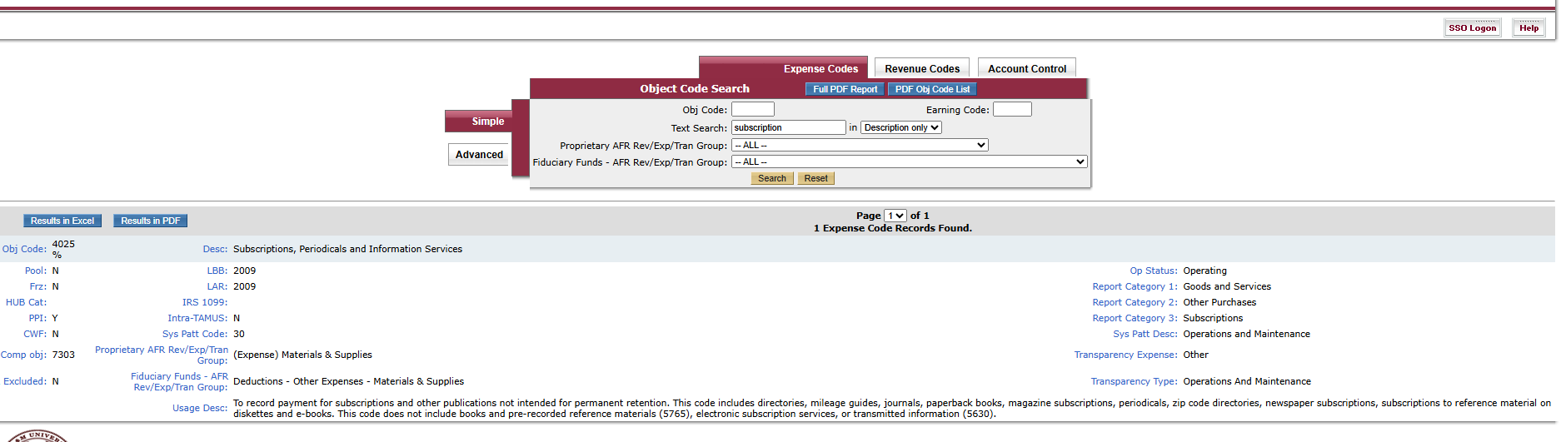
COMMODITY CODES/OBJECT CODES
Subscription
https://apps2.system.tamus.edu/objcodes/

Slide 5
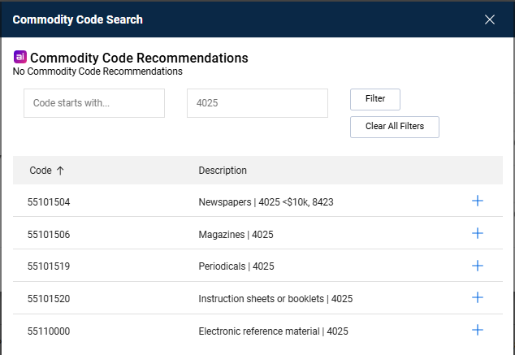
COMMODITY CODES/OBJECT CODES
Subscription

Slide 6
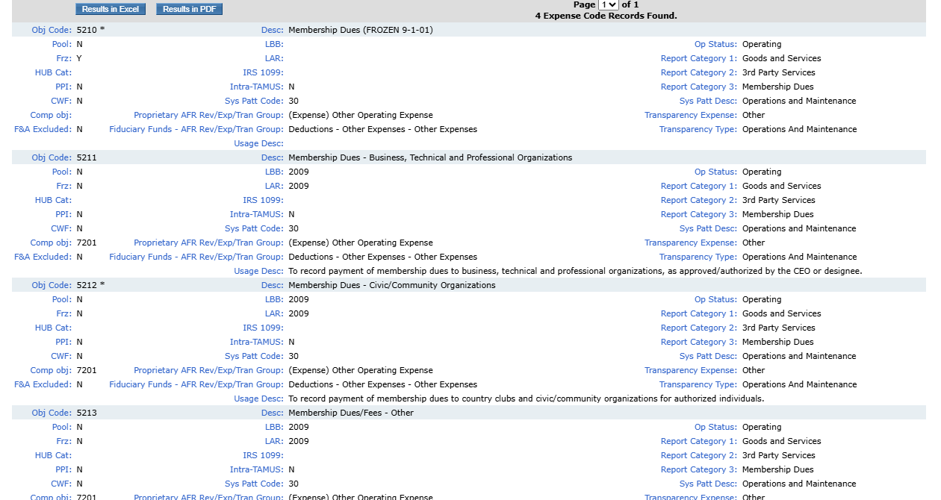
COMMODITY CODES/OBJECT CODES
Membership
https://apps2.system.tamus.edu/objcodes/

Slide 7
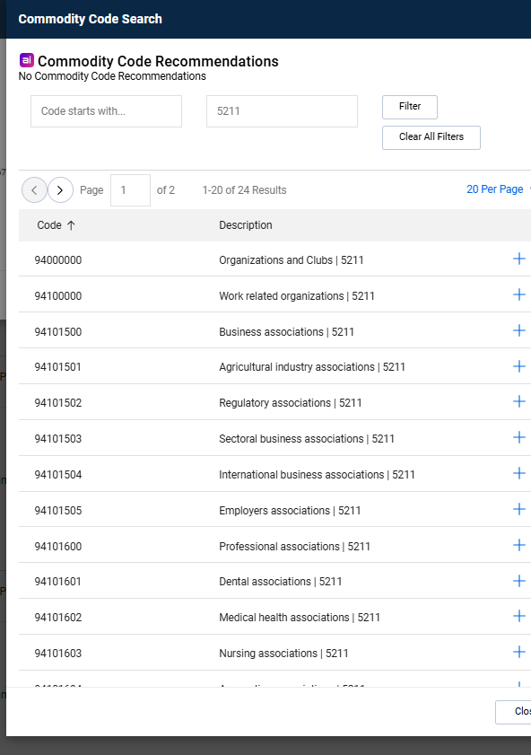
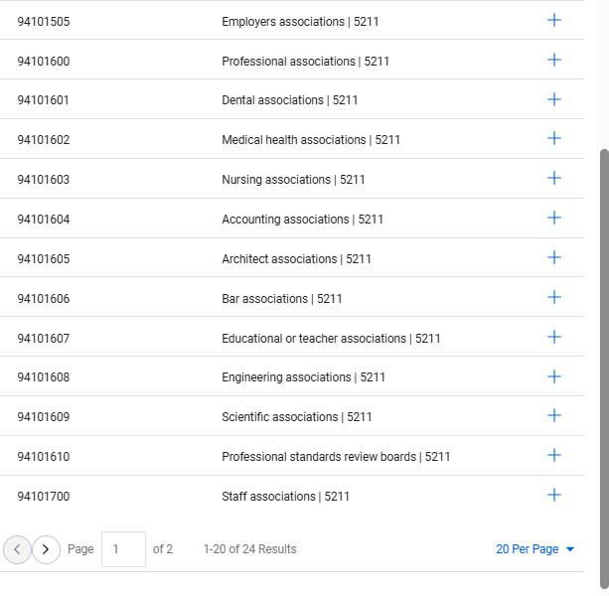
COMMODITY CODES/OBJECT CODES
Membership

Slide 8
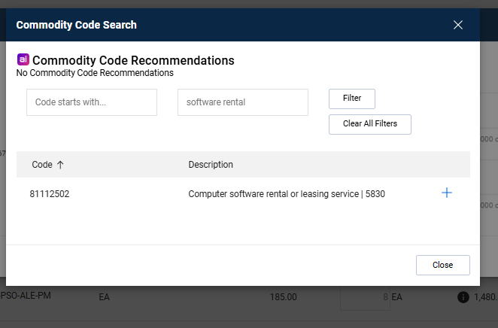
COMMODITY CODES/OBJECT CODES
Software Rental, 5830

Slide 9
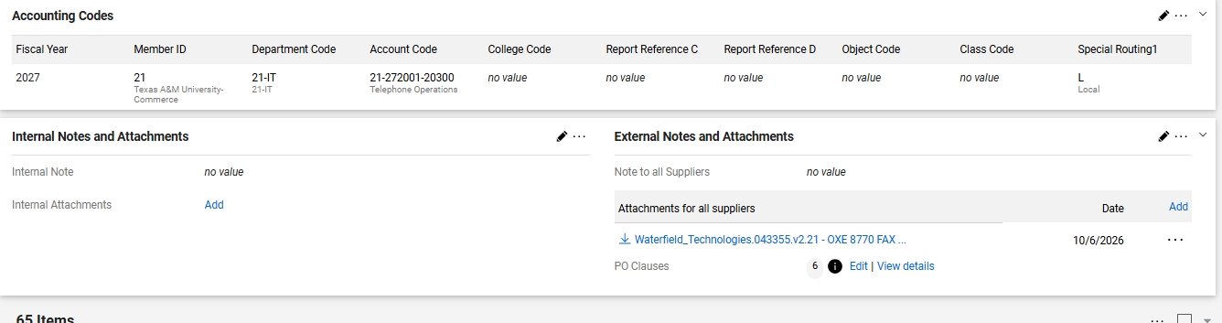
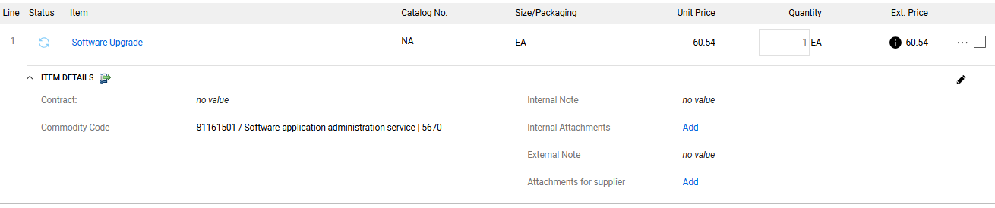
Attachments go under the attachment section
NOT at the line-item level

Slide 10

Attachments go under the attachment section
ALL attachments should be put on the PO.
Please do not put attachments under the Receipts tab
Please do not put attachments under the Invoice tab, on the invoice.
Everything you do regarding attachments, on a PO, should be under the Comments tab or that Attachment Tab.

Slide 11
Vendor Verify – When do I need one?
No longer a requirement on requisitions.
ONLY when you swipe your One Card to purchase something that is $500 or greater. ANY VENDOR, ANY PURCHASE $500 or more.
MUST be pulled the exact same day as the purchase
OR SEVEN DAYS PRIOR to purchasing.
https://inside.tamuc.edu/facultystaffservices/purchasing/One_Card_Non_Travel/forms.aspx

Slide 12

Our University Name is East Texas A&M University
We HAVE TO HAVE Quotes and Invoices with the correct university name on them.
We are now East Texas A&M University, and all paperwork should reflect that.
We need each of you to please be responsible for each of your requisitions and circle back with your vendor to get this corrected immediately.
We are now on two years being ETAMU.

Slide 13
Comments from Invoices
Please ensure that all communication with the Invoices team stays within AggieBuy.
If someone from Invoices leaves a comment on an invoice, please respond in the same comment box on that invoice.
If someone from Invoices leaves a comment on a PO, please respond in the same comment box on that PO.
Please do not respond privately via email. Keeping all correspondence within AggieBuy ensures that communication remains documented in the appropriate place and is accessible to those who need it.
Thank you for your cooperation!

Slide 14
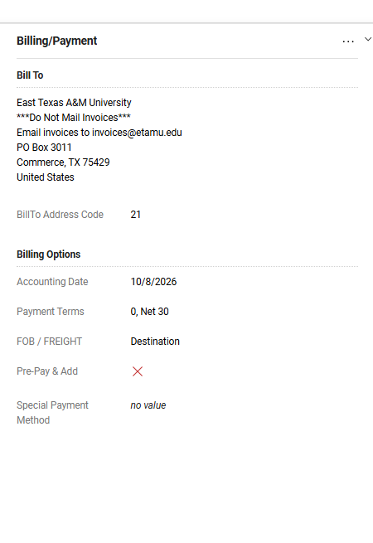
Special Payment flag
On a requisition, there is a flag for
Special Payment. DO NOT USE ‘Rush for Payment’.
Ironically, this will slow down that process.
Remember there are 11 universities under the
Flagship college of Texas A&M that use Aggiebuy
so there are a lot of features that we don’t use here,
but the other colleges do.

Slide 15
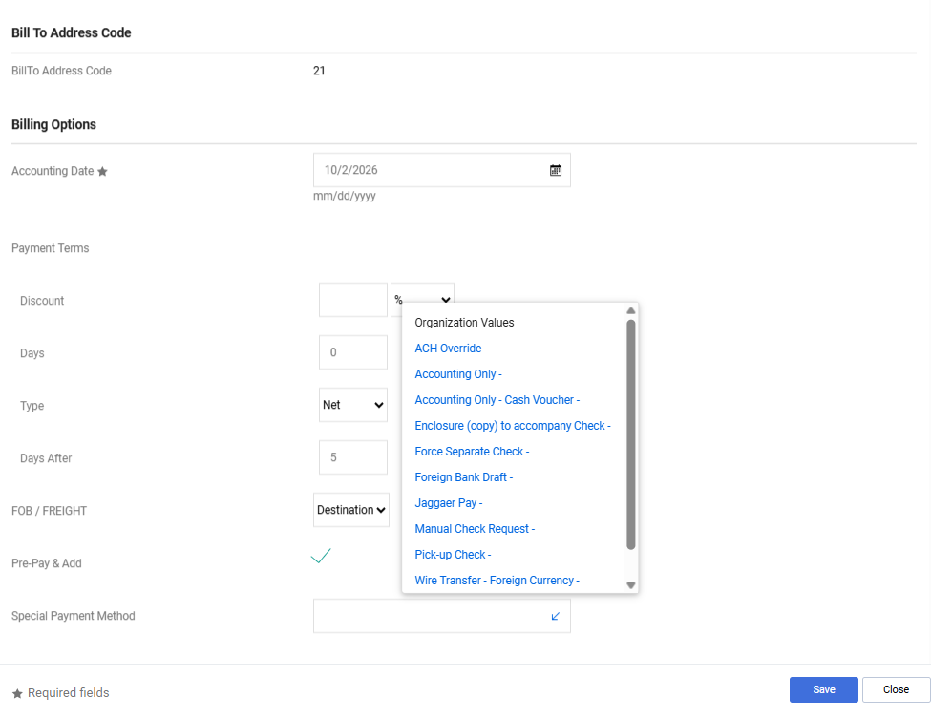
Special Payment flag

Slide 16
Change Requests
We are now reviewing Change Requests with the same level of scrutiny as Requisitions and Purchase Orders (POs).
As part of this process, we will evaluate the additional costs associated with each Change Request to ensure they comply with the University’s procurement policies and the requirements of the respective departments.
Bid Limits
$0 - $15,000 “No-Bid Limit”
$15,000.01 - $50,000 “Informal Bid Limit”
Over $50,000 “Formal Bid Limit”

